Slide 1


Slide 2
What is Sentry
Sentry’s real-time error tracking gives you insight into production deployments and information to reproduce and fix crashes
Notes:
With sentry you will know when things break Get notifications via email, sms, or chat when new errors occur or old ones resurface.
See the impact of each release If things break, you’ll know where errors are happening, how often they happen, and who is affected.

Slide 3
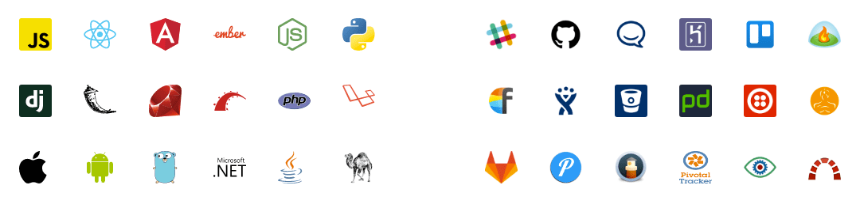
Sentry tracks errors in all major languages and frameworks
It also integrates with your favorite apps and services

Slide 4
Using Sentry with React App
We start by generating our react application:
Then we import the Sentry package:

Slide 5
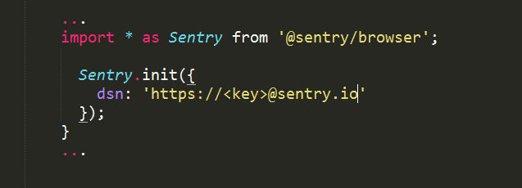
Initialize sentry:
react-app / src / index.js
Notes:
To get a security key you need to register your project on https://sentry.io.

Slide 6
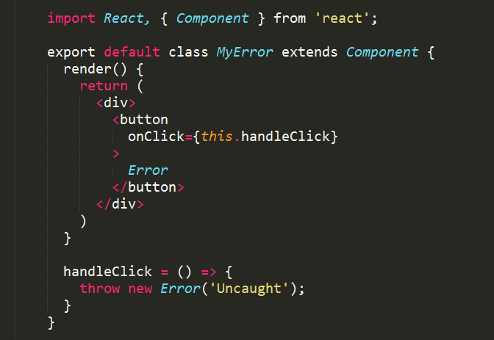
We will create a component that throws unhandled error
react-app / src / MyError.js

Slide 7
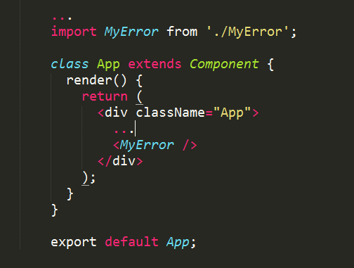
Then we add our “Error button” to the application:
react-app / src / App.js

Slide 8
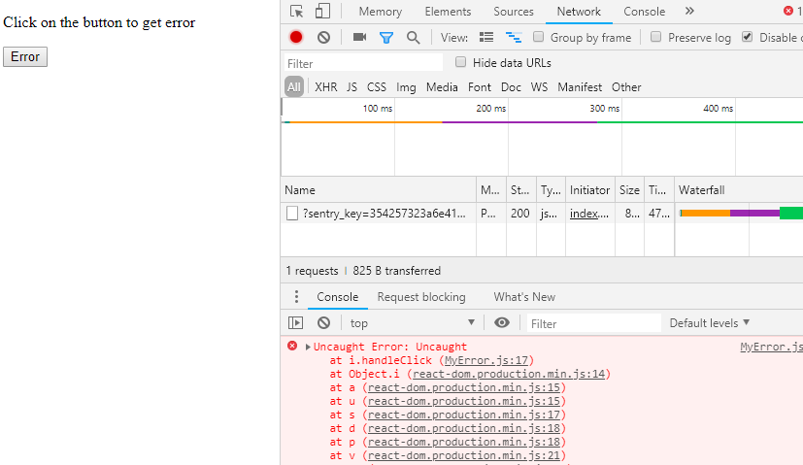
After we build application and served it:
Notes:
As you request is sent to Sentry with error detail

Slide 9
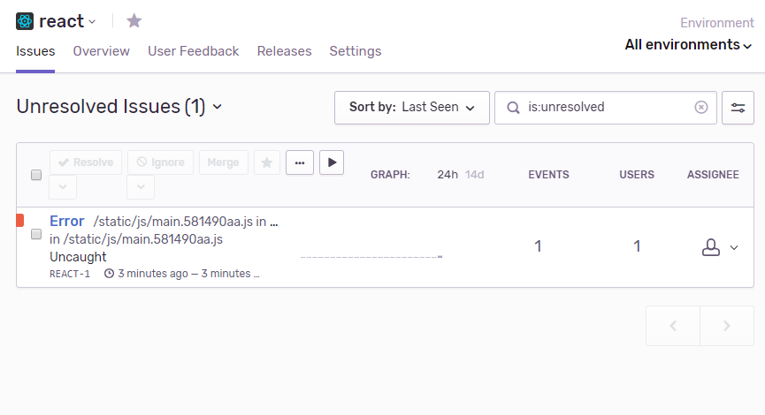
Sentry UI
Notes:
Sentry logged an error

Slide 10
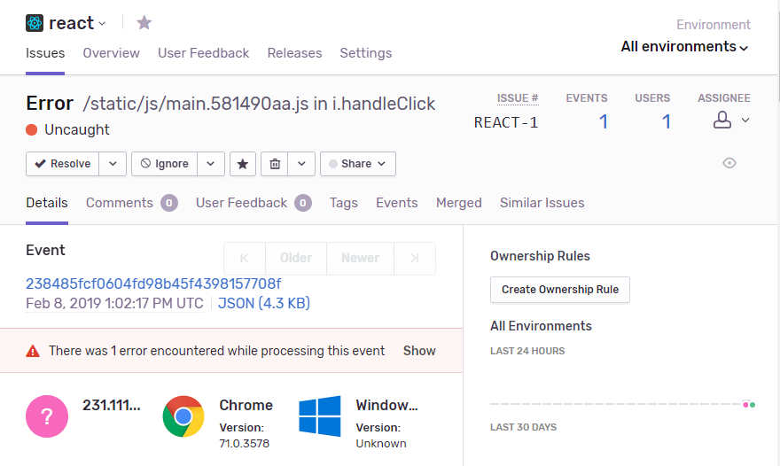
Error details
Notes:
Details can be examined to determine the product version, issue severity, OS, browser, IP address, dates, call stack, etc:

Slide 11
Sentry.io features beyond the basics include:
configuration settings to define release versions, code repositories, server names, URLs, etc.
user information, messages, tagging, and custom events
user feedback widgets to record further information
inbound message filtering rules
issue assigning to team members
bookmarking, resolving, ignoring, sharing and deleting issues
activity and issue reports
a command-line executable to report OS or build issues
a full API to submit, retrieve, update, delete and manage event data
robust security with optional two-factor authentication
chat integration with Slack, HipChat and others
commercial and community support options.

